Slide 1

Microsoft Movie Exploration
Titilayo Amuwo
Flatiron Student

Slide 2

Overview
This project analyze different types of movie titles that is currently doing the best at the box office and how it relates to profit.

Slide 3
Understanding the Problem
Microsoft has decided they want to create original content as well as created their own movie studio. Unfortunately, Microsoft has no prior knowledge of the movie industry so they don’t know how to move forward in creating content.
Analyze Data and provide microsoft the best recommendation for a profitable movie studio.

Slide 4
Methodology
Analyse the past movie datas within the range of ten years to make the best recommendation to Microsoft on how to be successful in the movies industry.
zipped data- (Imdb Basics, tn, and bom movies)
ROI = Revenue-cost *100
cost

Slide 5
Recommendation One
My analysis shows that 69% of the median profit for the movies have a higher production budget.
My recommendation for microsoft is to look into a production budget that correlates with a very high percentage of Return on Investment.
Visuals on Slide (6)

Slide 6
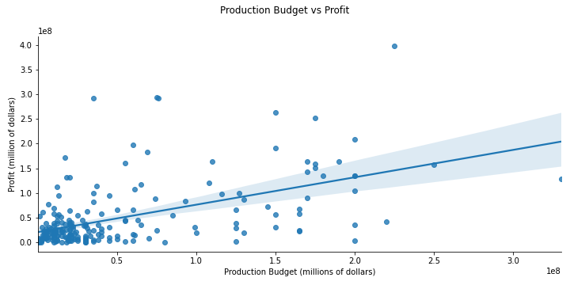


Slide 7
Recommendation Two
My recommendation for microsoft is to look into the genres when they decided to make a movie.
For example, If you look at my graph(slide 8). My Analysis show that Adventure and Action genres seem to have more than an average counts.

Slide 8
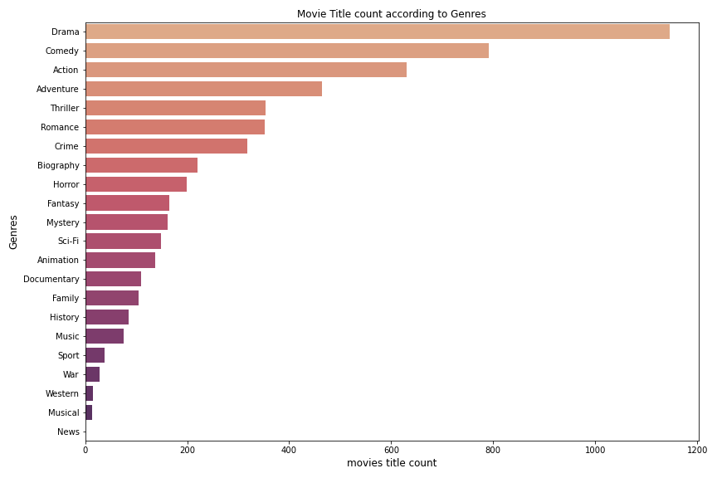

Slide 9
Recommendation Three
My Analysis shows that 50% of the total net profits across all genres come from just the top five genres which are ; Action, Adventure, Sci-Fi, comedy, and Animation.
I would recommend Microsoft to focus on Action, Adventure and Sci-Fi for high net profits.
Microsoft can put a survey on social media for votes or pick between the Top five listed on my graph(slide 10).

Slide 10
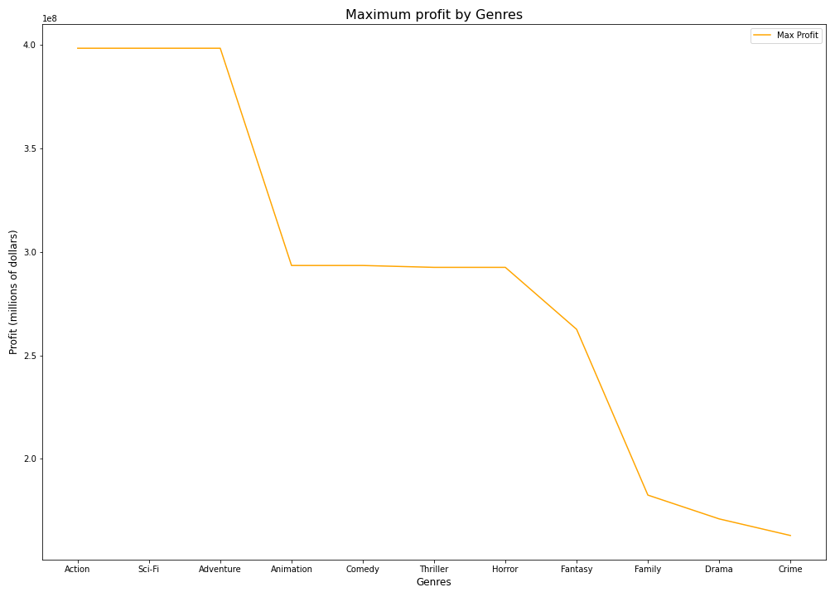

Slide 11
Recommendation Four
If Microsoft wishes to produce the best movies to make a higher profit, they need to look into the movie runtime and its relationship to profit.
The average runtime for the top five genres is 102.00 mins at that point, the median profit is very high.This needs to be considered when producing the movie.

Slide 12
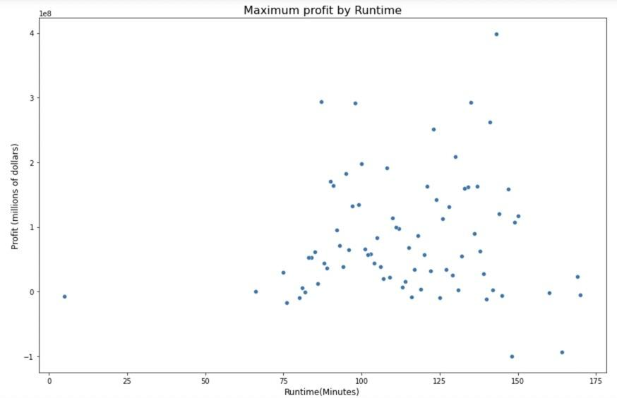

Slide 13
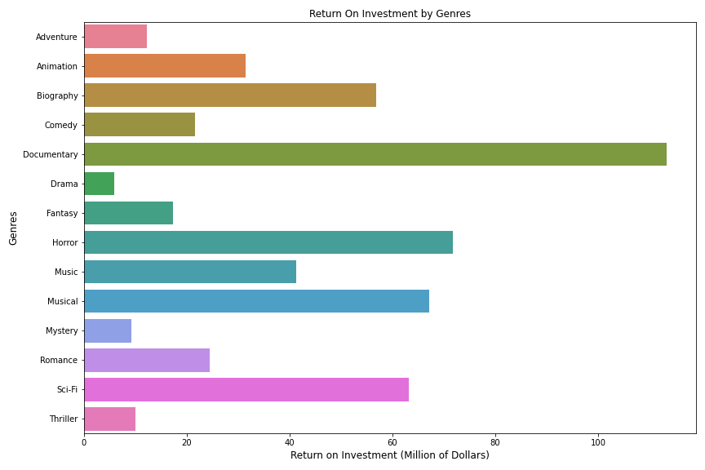

Slide 14
Future Consideration
Does the opening weekend box office gross have a strong correlation with the profit?
How much of an impact does premiering a movie have if the movie have a major box office release.
Analyze the data for producers in addition to actors and directors.
Analyze studio performance and Theater

